Slide 1
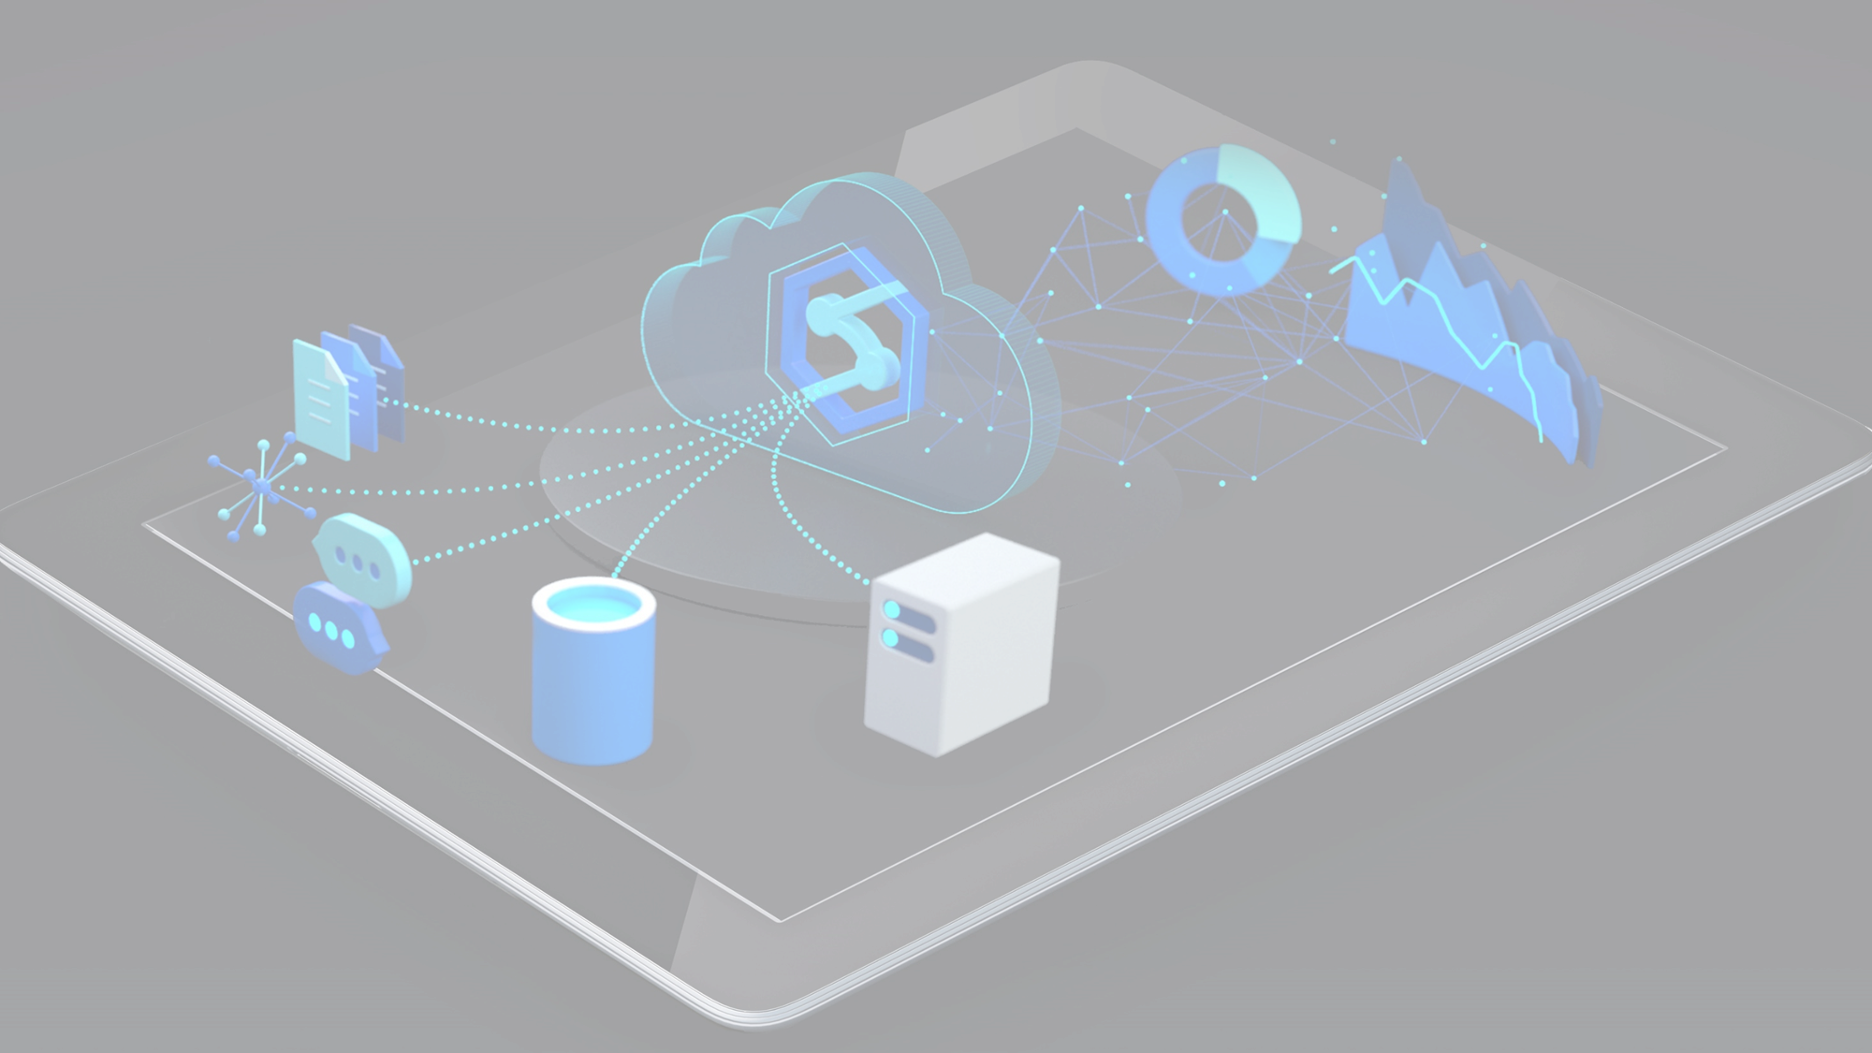
Azure Synapse for Actuaries Solvency II Use Case
Brent Carpenetti
Senior Actuary
Hannover-RE
Hiram Fleitas
Senior Customer Engineer
Microsoft Data & AI
https://bit.ly/SOABrentHiram

Slide 2
Azure Synapse for Actuaries Solvency II Use Case
Brent Carpenetti
Senior Actuary
Hannover-RE
Hiram Fleitas
Senior Customer Engineer
Microsoft Data & AI
https://bit.ly/SOABrentHiram

Slide 3
Azure Synapse for Actuaries Solvency II Use Case
Brent Carpenetti
Senior Actuary
Hannover-RE
Hiram Fleitas
Senior Customer Engineer
Microsoft Data & AI
https://bit.ly/SOABrentHiram

Slide 4
Azure Synapse for Actuaries Solvency II Use Case
Brent Carpenetti
Senior Actuary
Hannover-RE
Hiram Fleitas
Senior Customer Engineer
Microsoft Data & AI
https://bit.ly/SOABrentHiram

Slide 5

What is Solvency II?
Solvency II is a risk-based capital regime, similar in concept to Basel II, implemented for European insurers on 1 January 2016. The risk-based capital requirement, the Solvency Capital Requirement (SCR), is calculated using either the standard formula; an approved internal model; or a mixture of both. The calculation is calibrated to a 99.5 per cent confidence level over a 1-year period.

Slide 6
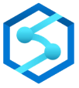
What is Synapse Analytics?
Is a limitless analytics service that brings together data integration, enterprise data warehousing, and big data analytics. It gives you the freedom to query data on your terms, using either serverless or dedicated resources—at scale. Azure Synapse brings these worlds together with a unified experience to ingest, explore, prepare, and serve data for immediate BI and machine learning needs.

Slide 7
Why?
Hannover Internal Model: 100,000 Scenarios
Excel is too delicate to mange the data size.
Isolated SQL server is technically daunting.
R versioning and libraries impede collaboration.
Business processes often experience delays
Leverage data science and collaborate with IT.
Optimize automation to maximize human capital.
Learn to be programmatically DRY - Don't Repeat Yourself.
Modernized workflows create better results
Less time spent operating the process.
More time spent evaluating outcomes of the process.
Generate opportunities to achieve improvements.

Slide 8
How?
Modernize intelligent R & SQL
R is best used for model or statistics heavy workloads
SQL is best used for data management workloads
Collaborate with Azure DevOps
Code management to decrease knowledge silos
Task management to improve activity coordination
Automate with Azure Data Factory
Expose current process flows to all team members
Enable real time monitoring and completion tracking
Unify the experience with Synapse
Notes:
WIFM – Whats in it for me.
Include Before/After scenario of an ERM dept. – reuse content from Ophelia/Brent’s team slides.
Do they know what R is? Yes.
Do they know what SQL is? Maybe. Have a slide to tell them. Before that first SQL Demo.
Have a slide to tell them what DevOps is a process and Azure DevOps itself as a tool.
Have a slide to tell them what ADF as a SaaS tool.

Slide 9
Agenda
Demo intelligent R & SQL
Demo Azure DevOps
Demo Azure Data Factory
Demo Synapse
What’s Next & Resources
Notes:
WIFM – Whats in it for me.
Include Before/After scenario of an ERM dept. – reuse content from Ophelia/Brent’s team slides.
Do they know what R is? Yes.
Do they know what SQL is? Maybe. Have a slide to tell them. Before that first SQL Demo.
Have a slide to tell them what DevOps is a process and Azure DevOps itself as a tool.
Have a slide to tell them what ADF as a SaaS tool.

Slide 10
Eval
Your feedback is appreciated.
bit.ly/hiram720eval

Slide 11




Scenario
Pipeline passes a parameter
Logic App requires a change
DevOps for source control & CI/CD
VS Code for tooling
Azure
Data Factory
Logic App
DevOps
VS Code

Slide 12
Demo
R Desktop Bad-Case Scenario (Start)
R on the Server (Interim)
R in the database & Azure Data Studio (Finish)

Slide 13


Slide 14


Slide 15
✅ Connected Logic App to repo

Slide 17
Ctrl + Shift + P
(Command Palette)

Slide 19
✅ Connected Logic App to repo
✅ Cloned repo
✅ Installed extensions

Slide 20


Slide 22
Summary
Connected Logic App to Azure DevOps
Commit changes in VS Code using Logic Apps extension
Deployment Center automatically facilitated CI/CD
Azure
Data Factory
Logic App
DevOps
VS Code

Slide 23
Resources
Azure Logic Apps – Build powerful integration solutions.
https://aka.ms/logicapps
Azure DevOps – Plan smatter, collaborate better, and ship faster.
https://aka.ms/devops
VS Code – Free. Built on open source. Runs everywhere.
https://aka.ms/vscode

Slide 24
Eval
Your feedback is appreciated.
bit.ly/hiram720eval

Slide 25
Thank you
Hiram Fleitas
https://aka.ms/hiram
https://bit.ly/hiram720

